Slide 1

Packages, Interfaces & Exception Handling
Unit II-Chapter No. : 4-Exception Handling

Slide 2

Content
Explain packages, Interfaces and Exception handling mechanism of java
Write java program to create code library using packages
Write a java program to manage run time errors using java exception handling mechanism.
Write a java program to implement interfaces for a given problem specification.
School of Computer Science & Engineering

Slide 3
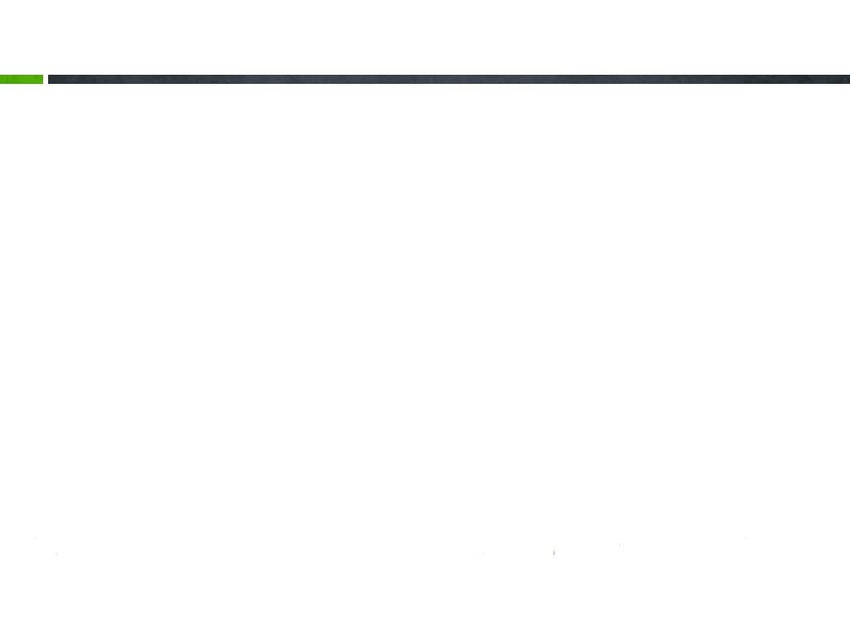
Content
Packages: Define, create, access protection and importing packages
Interfaces: Define, create interface and implement Method overriding
Exceptions: Define, Exception handling fundamentals, classification: Exception Types.
Using throw, throws, finally keywords to manage exceptions.
User Defined Exceptions
School of Computer Science & Engineering

Slide 4
Exception Handling: Basics
Exception Handling Fundamentals
Exception Types
Uncaught Exceptions
Using Try and Catch
Multiple catch Clauses
Nested try Statements
throw, throws and finally
Java’s Built-in Exceptions
Creating your own Exception Subclasses
School of Computer Science & Engineering

Slide 5
Exception Handling Fundamentals
Types of Errors
  Syntax errors
  Logical errors
  Run time errors (exception)
Define
  An exception is an abnormal condition that arises in a code sequence at run-time.
  An exception is a run-time error
  A java exception is an object that describes an exceptional condition that has occurred in a piece of code at run-time
School of Computer Science & Engineering

Slide 6
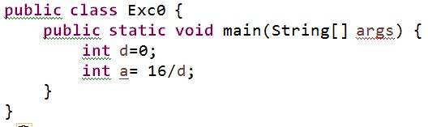
Exception: Object describes run-time error
Example– uncaught exception
  Consider following code snippet and predict output
  The output may be: run-time error, because violating language constraint , i.e division of any number by zero is not supported.
  The exception condition in above code snippet is division by ZERO.
School of Computer Science & Engineering

Slide 7
Exception: Object describes run-time error
When an exceptional condition arises, an object representing that exception is created and thrown in the method that caused the error.
That method may choose to handle the exception itself or pass it on.
At some point of time the exception is caught and processed
Exceptions can be generated by the java run-time system, or they can be manually generated by our code.
In pervious slide code snippet, the main method is not processed the run time error, the default error handler – the java run-time system is processed the error.
School of Computer Science & Engineering

Slide 8

The default handler displays a string describing the exception, prints a stack trace from the point at which the exception occurred and terminates the program.
Here is the exception generated when the previously defined code snippet is executed.
Notice the description of run-time error.
The type of exception thrown is a sub class of Exception called ArithmeticException
The default exception handler provided by the java run-time system is useful for debugging
School of Computer Science & Engineering

Slide 9
Key words to manage run-time error
Java exception handling is managed via five keywords
  try, catch, throw, throws and finally
try block – program statements to monitor for exceptions are contained in a try block
catch block – error handler, program statements to take actions when exceptions occurred in try block
throw-- to manually throw an exception
throws- to specify any exception that is thrown out of method
finally - A code that absolutely must be executed after try block completes is put in a finally block
Note : the above key words usage can be understood by using with some example.
School of Computer Science & Engineering

Slide 10
General syntax: Exception handling
try{
// block of code to monitor for errors
}
catch (ExceptionType1 exOb){
// exception handler for ExceptionType1
}
catch (ExceptionType2 exOb){
// exception handler for ExceptionType2
}
//…
finally{ // block of code to be executed after try block ends}
School of Computer Science & Engineering

Slide 11
Using try and catch
Although the default error handler is useful for debugging, usually we have to handle an exception our self.
The two benefits are
  It allows to fix the error
  It prevents the program from automatically terminating
Example : use try and catch block
  Next slide
School of Computer Science & Engineering

Slide 12
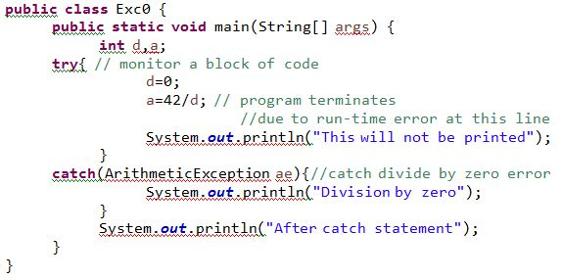
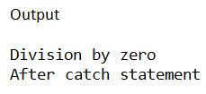
Using try and catch: Example
School of Computer Science & Engineering

Slide 13
Exception Types: Exception class hierarchy
overrides toString()
Object
Throwable
Exception
Error
RuntimeException
School of Computer Science & Engineering

Slide 14
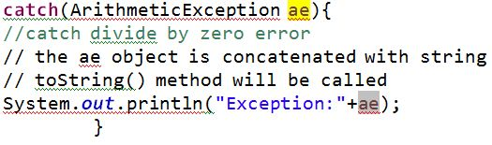

Displaying a Description of an Exception
The Throwable class overrides the method toString() of Object class,
Hence the object of any Exception type is used in println method, it will print description of that object
Example
School of Computer Science & Engineering

Slide 15
Multiple catch clauses
In some cases, more than one exception could be raised by a single piece of code.
Then, we can specify more than one catch clauses, each catching a different type of exception
When an exception is thrown, each catch statement is inspected in order, and the first one whose type matches is executed.
School of Computer Science & Engineering

Slide 16
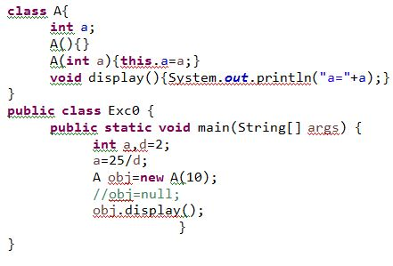
Multiple catch clauses: example
School of Computer Science & Engineering

Slide 17
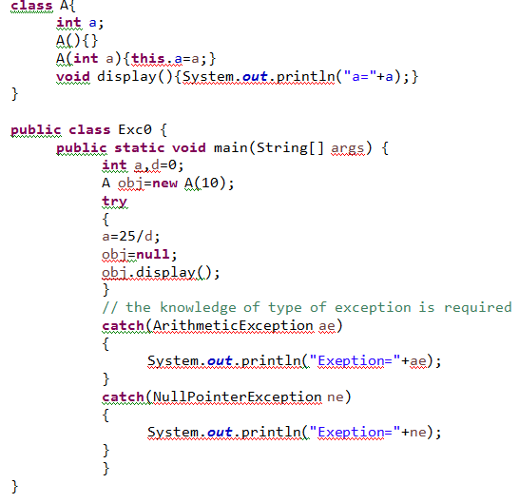
Multiple catch clauses: example
School of Computer Science & Engineering

Slide 18
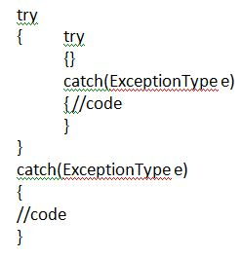
Nested try statements
The try statement can be nested: A try block with in another try block is called nested try statements.
General syntax
If an inner try statement does not have a catch handler for a particular exception, then next try statement’s catch handlers are inspected for a match. This continuous until one of catch statement succeeds. If no catch statement matches, then the java run-time system will handle the exception.
School of Computer Science & Engineering

Slide 19
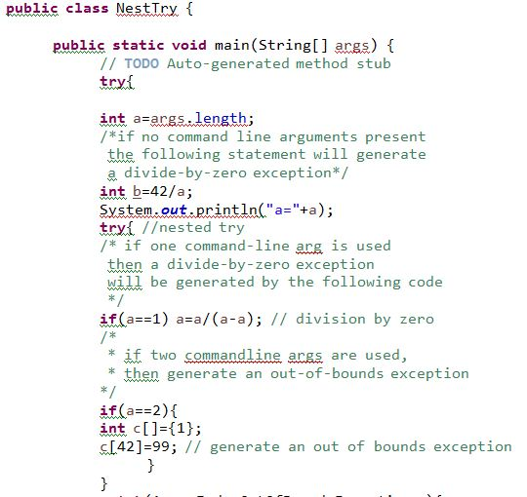
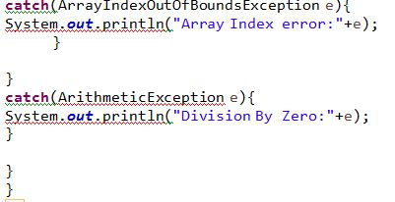
Nested try: example
School of Computer Science & Engineering

Slide 20
throw key word usage
So for , we have only been catching exceptions that are thrown by Java run-time system.
  ArithmeticException
  NullPointerException
  ArrayIndexOutOfBoundsException
However, it is possible to our program to throw an exception explicitly, using the throw statement
The general form of throw is follows
throw ThrowableInstance;
The ThrowableInstance must be an object of type Throwable or subclass of Throwable
School of Computer Science & Engineering

Slide 21
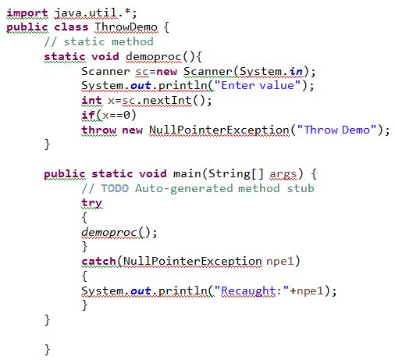
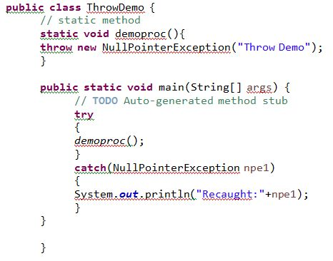
throw key word usage …..
The flow of execution stops immediately after the throw statement, any subsequent statements are not executed.
Example
School of Computer Science & Engineering

Slide 22
throws keyword
If a method is causing an exception that it does not handle, it must specify this behavior so that callers of the method can guard themselves against that exception.
Syntax:
type methodName(parameter-list) throws exceptionlist
{
//code
}
exceptionlist is a comma separated list
The exceptions in exception list can be other than Error or RuntimeException or any of its sub-classes.
School of Computer Science & Engineering

Slide 23
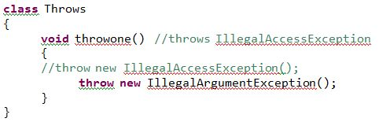
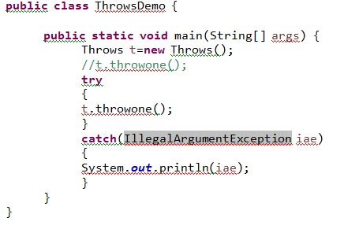
throws: example
Note: uncomment the first throw statement and test
It is also an example for checked and unchecked exception
School of Computer Science & Engineering

Slide 24
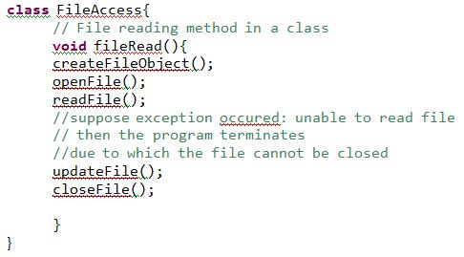
finally– keyword usage
When exceptions are thrown, the execution of the method takes a abrupt, nonlinear path that alters the normal flow through the method and return prematurely.
The above nature of exceptions in a method could create some problems, for example if a method opens a file upon entry and close it upon exit, then we do not want the code that closes the file to be bypassed by the exception handling mechanism.
School of Computer Science & Engineering

Slide 25
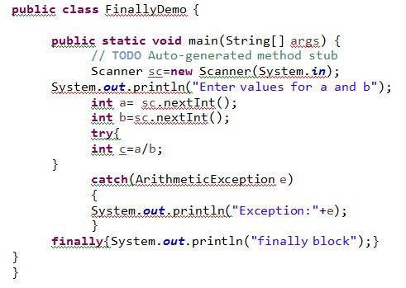
finally– keyword usage
The finally creates a block of code that will be executed after a try/catch block has completed and before the code following the try/catch block.
The finally block will execute whether or not an exception is thrown
School of Computer Science & Engineering

Slide 26
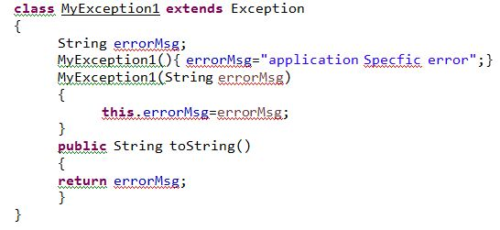
User Defined Exception
Although, Java’s built-in exceptions handle most common errors, we need to create our own exceptions to handle situations specific to our applications.
It is easy to create our own exceptions i.e by creating a class which extends Exception
User defined exception: create a class to describe runtime error by extending Exception built in class
School of Computer Science & Engineering

Slide 27
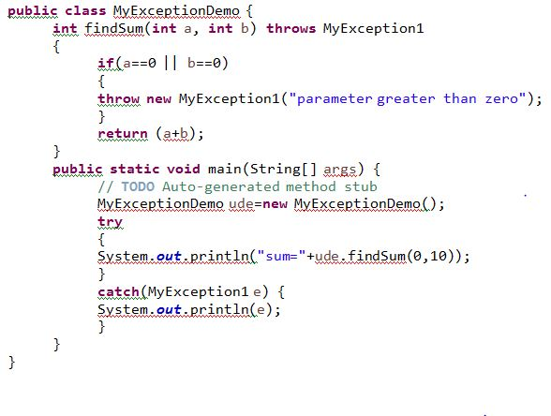
User Defined Exception
Next, create a application class and method which uses – userdefined exception
School of Computer Science & Engineering

Slide 28
Java Built-In exceptions
The RuntimeException is a subclass of Exception and theses exceptions need not be included in throws list of any method. These exceptions are called unchecked exceptions, because the compiler does not check to see if a method handles or throws these exceptions
If a compiler checks whether a method generates exception and does not list in throws clause , then these exceptions are called checked exceptions.
School of Computer Science & Engineering

Slide 29
Uunchecked RuntimeException
Exception | Meaning
ArithmeticException | Divide by zero
ArrayIndexOutOfBoundsException | Array index out of bounds
IllegalArgumentException | Illegal argument to invoke method
NullPointerException | Invalid use of null reference
StringIndexOutOfBoundsException | Similar array index problem
NegativeArraySizeException | Negative size
NumberFormatException | Invalid conversion of string to a numeric format
School of Computer Science & Engineering

Slide 30
Checked Exceptions
Exception | Meaning
ClassNotFoundException | Class not found
IllegalAccessException | Access to a class is denied
NoSuchFieldException | A requested field does not exist
NoSuchMethodException | A requested method does not exist
InterruptedException | A thread is interrupted by another thread
School of Computer Science & Engineering

Slide 31
Exercise
Define a class CurrentDate with suitable data members. Define suitable constructor to create CurrentDate object and accept the values from user to create date object. Identify at least two exception/runtime error conditions and apply user defined exceptions concept. Write a test program to create CurrentDate object and manage errors.
School of Computer Science & Engineering

